Slide 1
Mobivision Android App Dev Workshop

Slide 2
Day 1
Introduction to the SDK, Eclipse IDE
Introduction to basic classes of android APIs
Make a basic text hide/show and counter app
Deploy the app into phones/emulators
Read and understand the logcat

Slide 3
Android APIs
Android comes with over 5000 APIs
Introduction to Activity class
Simple Classes like TextView, ImageView, Button, EditText, RelativeLayout, LinearLayout, ScrollView etc.
Advanced classes like ListView, DrawerLayout, SwipeRefreshLayout, ViewPager etc.

Slide 4
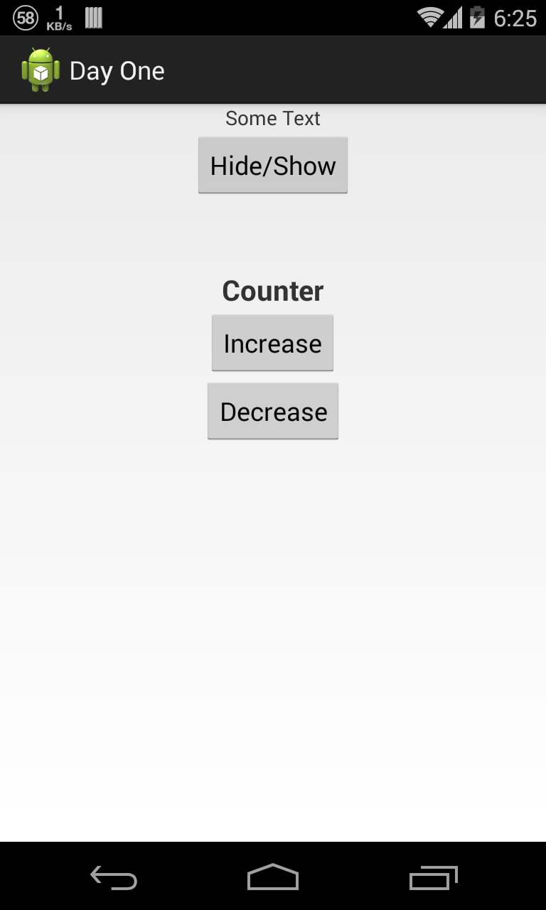
What you will be making today!

Slide 5
Emulators/Virtual Device
Android SDK comes with a feature of running virtual android device to test the app on you machine itself
Runs a full Android system stack
Includes a set of preinstalled applications
Features:
An ARM/Intel CPU
A 16-bit LCD display
Flash memory partitions (emulated through disk image files on the development machine)
A GSM modem, including a simulated SIM Card
A camera, using a webcam connected to your development computer
Sensors like an accelerometer, using data from a USB-connected Android device

Slide 6
Run your app on a physical device
Enable debugging over USB
Nexus device drivers included in your SDK
Other devices need special drivers which can be found at
http://developer.android.com/tools/extras/oem-usb.html#Drivers

Slide 7
LogCat
Android logging system provides a mechanism for collecting and viewing system debug output
Logs from various applications and portions of the system are collected
Identifying Java error logs and correcting them
Identifying XML error logs and correcting them
“FATAL EXCEPTION: <method>
Process: <package_name>, PID: <process_id>”

Slide 8
Day 2
Activities
Various UI components
Various XML attributes of various classes
Programme the UI
Intents
Overflow Menus
Shared Preferences
Make a basic calculator

Slide 9
Activity
An application component that provides a screen with which users can interact
An application usually consists of multiple activities that are loosely bound to each other

Slide 10
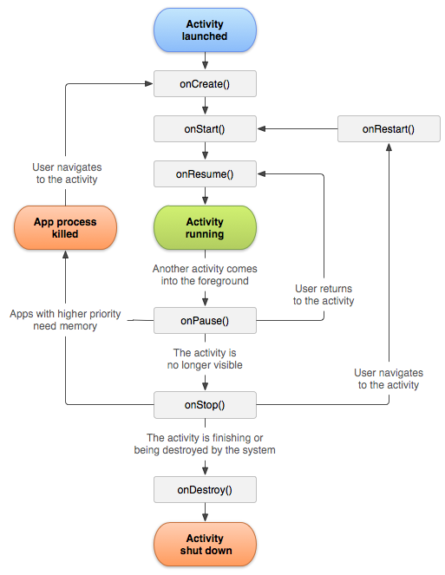
Activity Lifecycle

Slide 11
UI Components
Status Bar
Action Bar
Activity
Navigation Bar

Slide 12
UI Classes
TextView, EditText, ImageView, Button
RelativeLayout, LinearLayout, ScrollView
ProgressBar, ProgressDialog, AlertDialog
DrawerLayout, SwipeRefreshLayout

Slide 13
XML Attributes
<android:id>
<android:layout_width>
<android:layout_height>
<android:background>
<android:layout_margin>
<android:padding>
<android:layout_gravity>
<android:visibility>

Slide 14
UI Programming using Java
setContentView()
findViewById()
setVisibility()
setOnClickListener()
getActionBar()
setText()
Toast.makeText().show()

Slide 15
Intents
An intent is an abstract description of an operation to be performed
Can be used to start an Activity, send a Broadcast, communicated with a background Service
startActivity(new Intent(<activity>.this,<new_activity>.class));

Slide 16
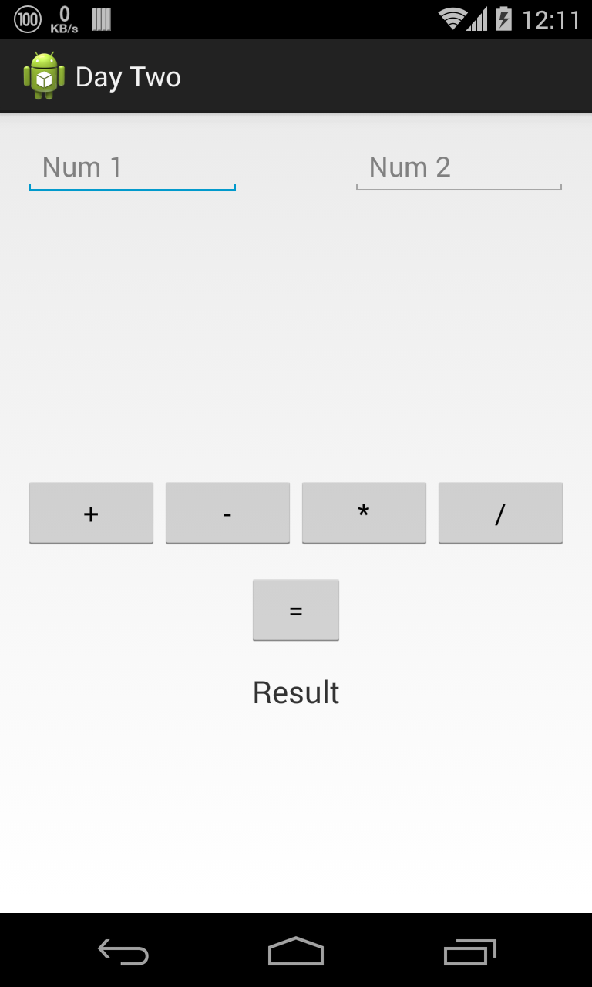
What you will be making today!

Slide 17
Day 3
ListView, Custom ListView Adapter
Introduction to External Libraries
Use Picasso Library
Make a custom ListView with two TextViews, an Image using Picasso

Slide 18
ListView & Custom Adapters
View group that displays a list of scrollable items
Content for a ListView is made using an adapter class
Adapter class fetches data from resource and places it into the list
listview.setAdapter(new CustomAdapter());

Slide 19
External Libraries
Provide added functionality or improvement to existing features
Come as both complete source or a .jar file
Picasso image loading library
Picasso.with(context).load(picturePath).into(imageView);

Slide 20
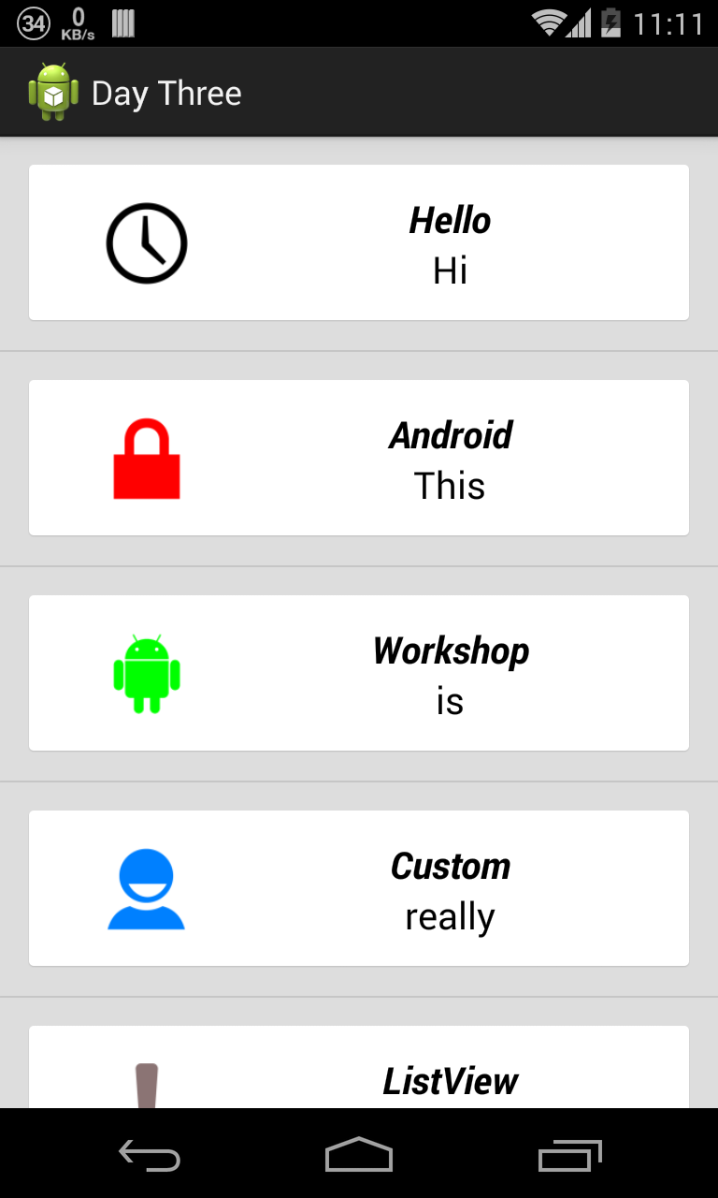
What you will be making today!

Slide 21
References
Android Developers page and API docs
http://developer.android.com/reference/packages.html
https://developer.android.com/guide/index.html
StackOverflow
http://stackoverflow.com/

Slide 22
For help and details
Contact
Kartik Arora
Phone: +918197738959
Email ID: chipset95@gmail.com
Turing events:
Robocode (Virtual robot dev using Robocode API)
Gamedev (2d Game dev using libgdx engine)
Mobivision (Android & iOS app dev)

